Slide 1
CS5560 Knowledge Discovery Management
Tutorial 6

Slide 2
Overview
LDA
python Implementation of LDA (genism)

Slide 3
Latent Dirichlet allocation (LDA)
LDA is a generative statistical model that allows sets of observations to be explained by unobserved groups that explain why some parts of the data are similar.

Slide 4
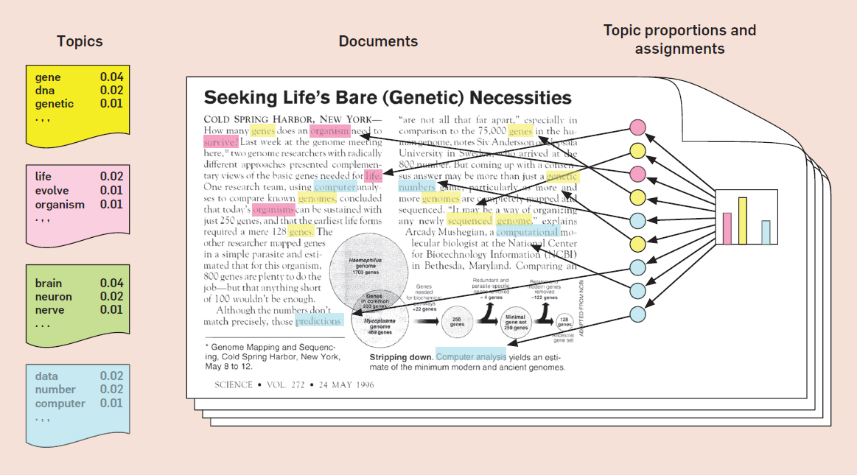
Latent Dirichlet allocation (LDA)

Slide 5
Python Libraries to install
Install the following with “pip install” in the terminal
nltk
gensim
pandas
pyLDAvis
IPython

Slide 6
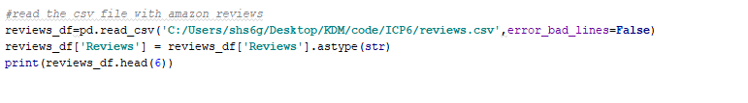
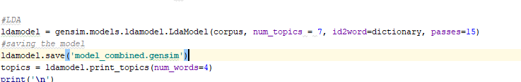
LDA Gensim
Setting Parameters such as
Input Path (Folder Location)
Number of Topics (k)
Number of words per topc

Slide 7
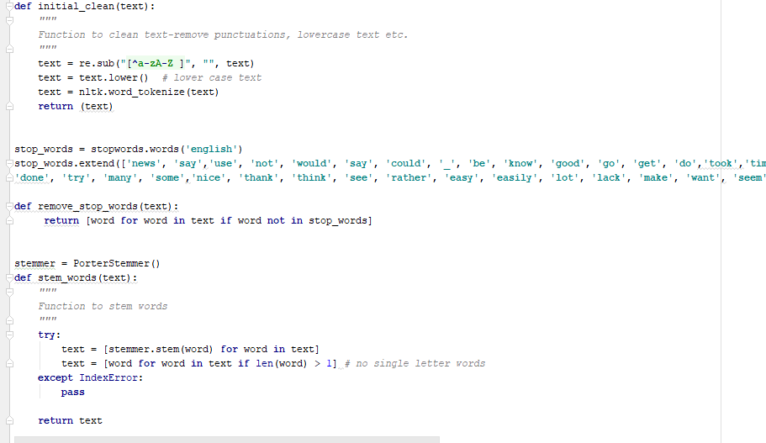
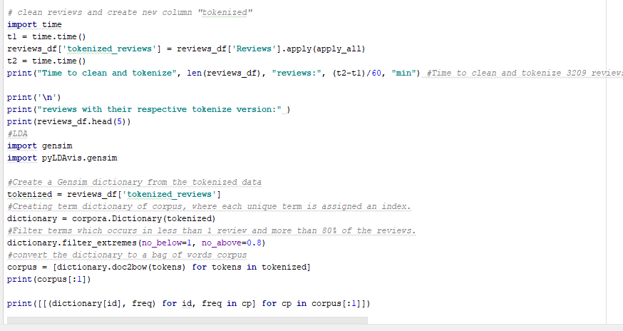
LDA Gensim
LDA Dataset is preprocess in following steps
Data => NLP => StopWordRemoval => TF => TFIDF
TFIDF Vector is sent to LDA.

Slide 8
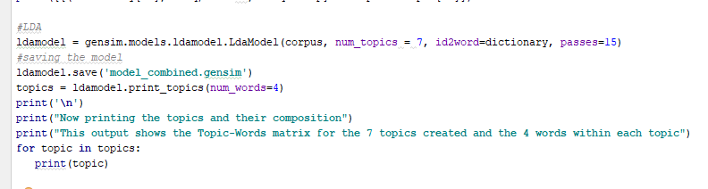
LDA Python
Identifying the corpus details.
Create LDA Model based on the parameters given
LDA is run on top of the corpus.
The topics generated are printed out.

Slide 9
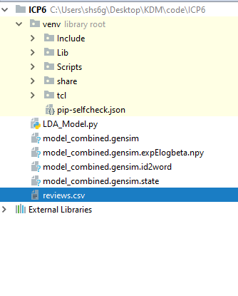
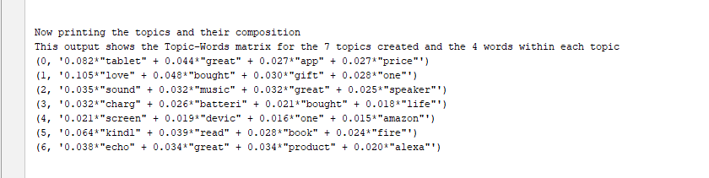
LDA Input and Output
Input
Output

Slide 10
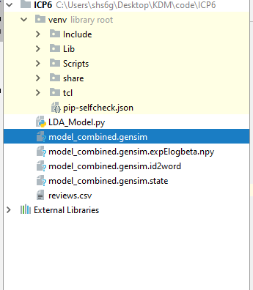
Saving the model results

Slide 11
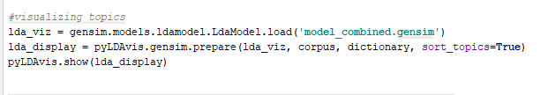
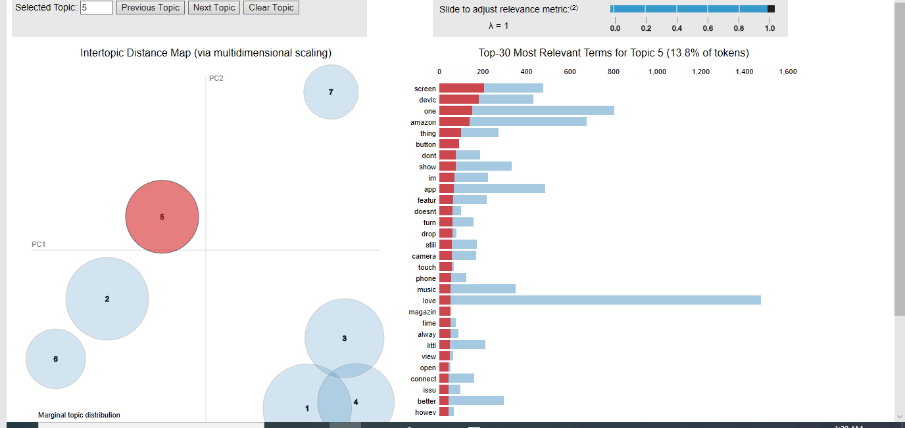
LDA dynamic visualization

